Slide 1


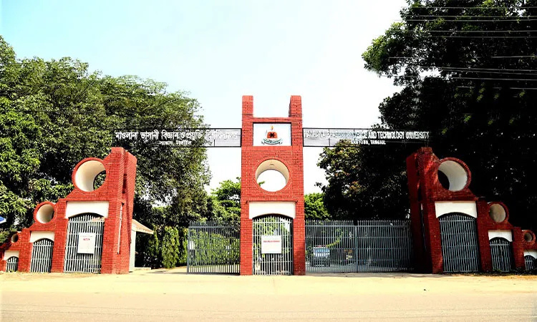

A visual presentation on
Points of Presence
(POPs)
Presented By :
SHAHRIER MOKAMMEL
IT24050
ID :
COURSE TITLE :
ICT-3101
DATA COMMUNICATION
COURSE CODE :
COURSE TEACHER :
Dr. NAZRUL ISLAM ,
ASSOCIATE PROFESSOR

Slide 2
Introduction to Points of Presence
USERS
A Point of Presence is a physical location where a network provider connects its network to users, other networks, or service infrastructure.
ISP PoP
PoPs act as both access points and interconnection points—bringing traffic onto a provider network, then exchanging or forwarding it toward the next destination.
OTHER NETWORKS
SERVICES

Slide 3

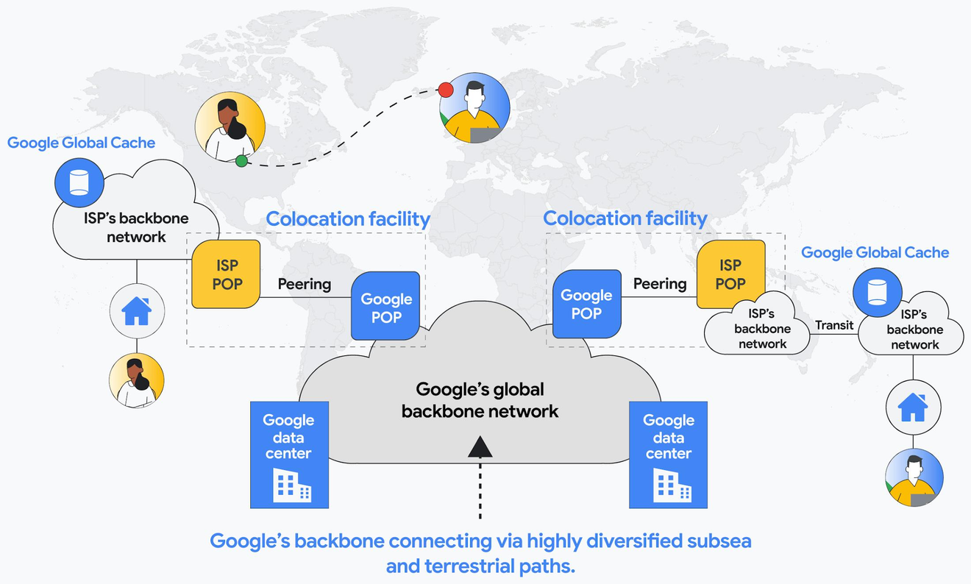
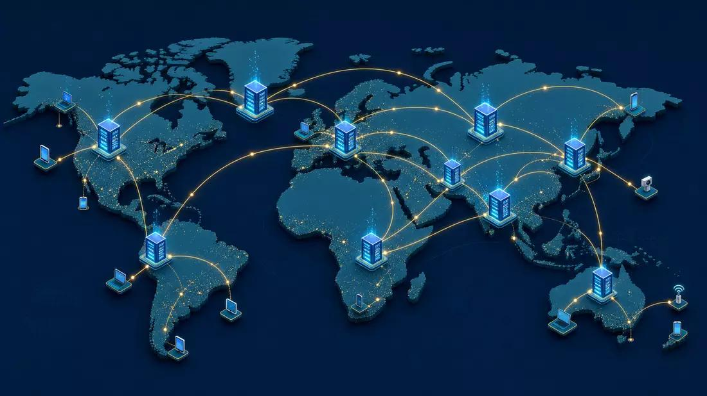
Points of Presence (PoPs) in Data Communication and Networking
Understanding Network Connectivity, Infrastructure, and Communication
Figure 1: Architecture of a Point of Presence (PoP) and its connection to
global network infrastructure.
Figure 2: Global network connectivity through geographically distributed Points of Presence.

Slide 4
Types of Points of Presence
Useful contexts—not rigid, mutually exclusive standards
Access PoP
Peering / exchange PoP
Cloud or service PoP
CDN edge PoP
Connects residential, campus, or enterprise users to a provider.
Places cached content and compute closer to audiences.
Supports traffic exchange with other networks at an interconnection site.
Provides nearby on-ramps to cloud platforms, applications, or managed services.
One facility may serve several of these roles at the same time.

Slide 5
How Does a PoP Work?
A request moves outward; the response follows a routed return path
REQUEST PATH
User device
Local access
network
ISP PoP
ISP backbone
Destination
server
RETURN PATH
At the PoP, routing and policy decisions determine the best available path into the provider backbone or toward a connected network.

Slide 6


Purpose and Importance of POPs
WHY ARE POPs IMPORTANT
PoPs provide access to a network from different geographical locations.
They reduce the distance that data must travel to reach users.
They help improve network performance and reduce communication delays.
PoPs support reliable communication between users, servers, and networks.
They allow service providers to expand their network coverage.

Slide 7

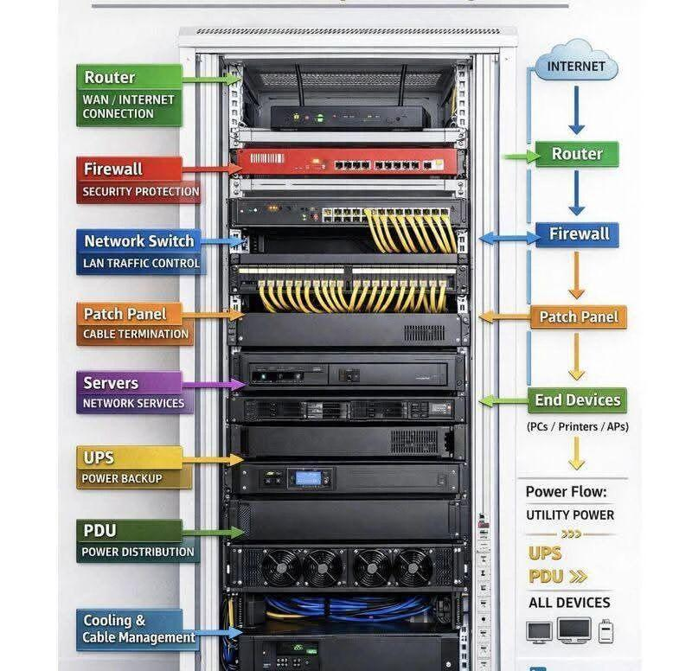
Main Components of a PoP
  ROUTERS : Forward data packets between different networks.
  SWITCHES : Connect devices within a local networks.
  SERVERS : Provide network services and applications when required.
  FIBER OPTIC CABLES : Carry data over long distances using light signals
  POWER & COOLING SYSTEMS : Maintain reliable operation of network equipment..
These components work together to establish and maintain network connectivity

Slide 8
Role of PoPs in Internet Service Providers
REGION A
REGIONAL PoP
ISP
BACKBONE
WIDER
INTERNET
REGION C
REGIONAL PoP
REGION B
REGIONAL PoP
Regional PoPs aggregate local customers, apply routing and security policies, and hand traffic into high-capacity backbone links.

Slide 9
Advantages of PoPs
1
2
Reduced latency
Local traffic exchange
3
4
Improved availability
Scalable regional growth
6
5
Optimized backbone use
Better user experience
Closer. Faster. More resilient.

Slide 10
Challenges and Limitations
PHYSICAL & OPERATIONAL COST
TECHNICAL COMPLEXITY
Facilities, rack space, fiber circuits, power, cooling, hardware refreshes, remote hands, monitoring, and security all create recurring expense.
More sites mean more routing policy, capacity planning, failure domains, configuration control, vendor coordination, and compliance obligations.
The design question is not “How many PoPs?” but “Where does each PoP create enough value to justify its lifecycle cost?”

Slide 11
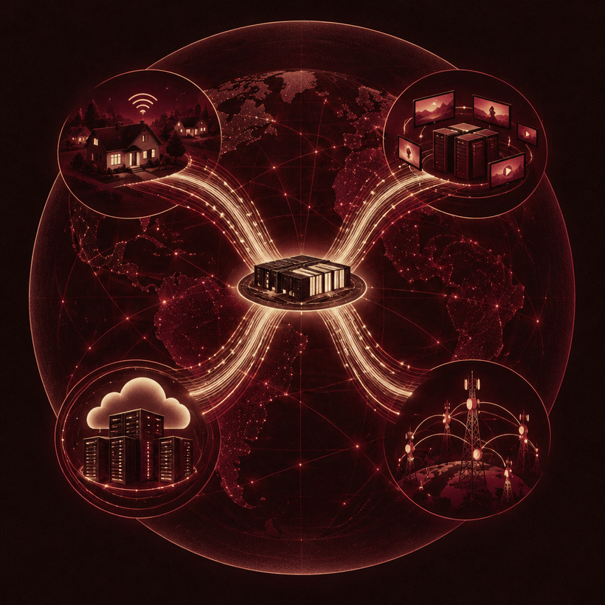
Real-World Applications of PoPs
ISP access
Local broadband and enterprise handoff.
CDN delivery
Cached media and web content near users.
Cloud connectivity
Private or optimized cloud on-ramps.
Telecom interconnection
Carrier handoff and traffic exchange.

Slide 12
PoPs bring networks
closer to where
connections happen.
They provide access, interconnection, lower latency, regional resilience, and efficient paths to services—while demanding careful investment and operational discipline.
THANK YOU

